Slide 1
Java Programming II
Events, AWT, and Swing
Java Programming

Slide 2
Contents
Events and Delegation Model
Overview of the AWT
Canvas
Button, TextField, List
Menu, MenuBar and MenuItem
Layout Managers
Panel
Swing
Creating New Window Frame
Dialogs and File Chooser
Java Programming

Slide 3


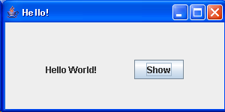
Using the ActionListener
Stages for Event Handling by ActionListener
  First, import event class
    import java.awt.event.*;
  Define an overriding class of event type (implements ActionListener)
  Create an event listener object
    ButtonListener bt = new ButtonListener();
  Register the event listener object
    b1 = new Button(“Show”);
    b1.addActionListener(bt);
Button Click Event
①
Class ButtonListener implements ActionListener {
public void actionPerformed(ActionEvent e) {
// Write what to be done. . .
label.setText(“Hello World!”);
}
}
ButtonListener
action
addActionListener
②
Java Programming

Slide 4
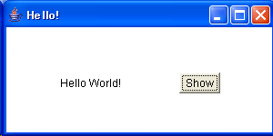
A Hello Example Using Button Listener
import java.awt.*;
import java.awt.event.*;
public class HelloAWT extends Frame { // Using Frame
Label contents;
Button dispbutton;
public HelloAWT() { // Constructor
setLayout(new FlowLayout(FlowLayout.CENTER, 50, 50));
contents = new Label(" "); // Create Label object
add(contents); // Add the label to this Frame
dispbutton = new Button("Show"); // Create Button object
dispbutton.addActionListener(new DispButtonListener()); // Add Event Listener
add(dispbutton); // Add the button object to this Frame
}
class DispButtonListener implements ActionListener { // Event Listener
public void actionPerformed(ActionEvent e) { // What to do when the button is clicked
contents.setText("Hello World!");
}
}
public static void main (String[] args) {
HelloAWT f = new HelloAWT(); // Create Hello GUI
f.setTitle("Hello!");
f.setSize(400,150);
f.setVisible(true);
}
} // end of “HelloAWT.java”
Run: Java HelloAWT
// Can be replaced by anonymous class
dispbutton.addActionListener(new ActionListener () {
public void actionPerformed(ActionEvent e) {
contents.setText("Hello Annoymus");
}
} );
Java Programming

Slide 5
Abstract Window Toolkit(AWT)
The Abstract Window Toolkit (AWT) and Swing provide standard components to build a graphical user interface (GUI)
The GUI enables interaction between the user and the program by using the mouse, keyboard, or another input device
The AWT provides a mechanism to paint different shapes on the screen (e.g., lines, rectangles, text, etc.), and create different elements on a screen (buttons, lists, and others)
Java Programming

Slide 6
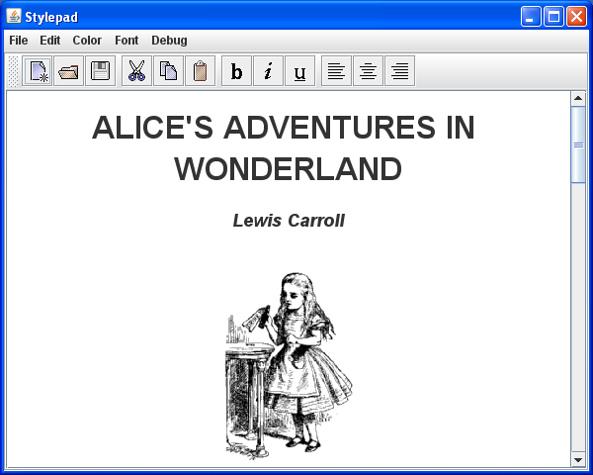
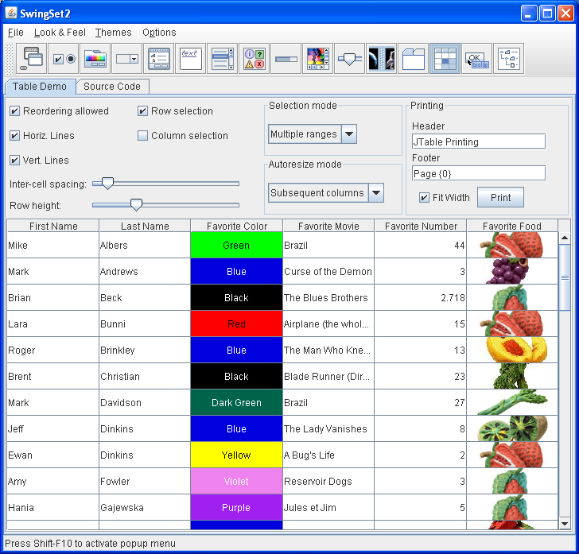
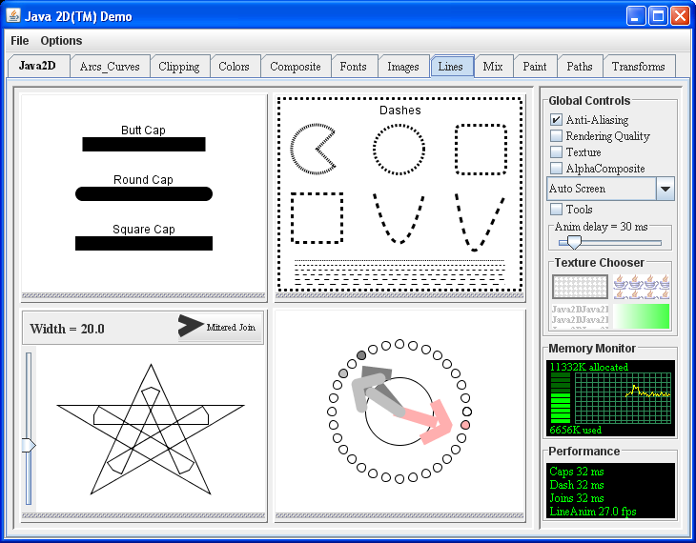
Example: GUI
Java Programming

Slide 7
AWT Class Hierarchy
Object
Component
MenuComponent
Button
Canvas
Container
Label
List
Scrollbar
MenuBar
MenuItem
TextComponent
Window
Panel
Menu
TextField
TextArea
Frame
Dialog
Applet
FileDialog
Java Programming

Slide 8
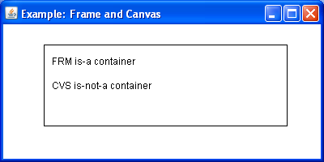
Example: Frame and Canvas
public class FRM extends Frame {
public FRM()
{
super("Example: Frame and Canvas");
add(new CVS()); // add a canvas to paint
setSize(400,200);
}
public static void main(String[] args)
{
new FRM().setVisible(true);
}
class CVS extends Canvas {
// paint this canvas
public void paint(final Graphics g)
{
g.drawRect(50,25,300,100);
g.drawString("FRM is-a container",60,50);
g.drawString("CVS is-not-a container",60,80);
}
}
}
A Canvas is used to draw some shapes on it using the Graphics. It has the paint method.
CVS is an inner class
A Graphics object is used to draw shapes on the canvas
FRM is a container – it contains a CVS object
Object
Component
Graphics
Canvas
Container
CVS
Window
Frame
FRM
Java Programming

Slide 9
Component
A component is an object having a graphical representation
Component is an abstract class
Components can be displayed on the screen
Components allow the user to interact with the program
Java Programming

Slide 10
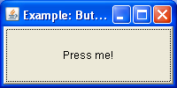
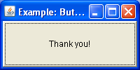
Button
A Button is a component that simulates the appearance of a push button
When the user presses the mouse inside a button an ActionEvent is generated
import java.awt.*;
import java.awt.event.*;
class BTN extends Frame {
BTN()
{
super("Example: Button");
final Button b = new Button("Press me!");
b.addActionListener(new ActionListener() {
// the event handler
public void actionPerformed(ActionEvent ae) {
b.setLabel("Thank you!"); }
});
add(b);
setSize(200,100);
}
public static void main(String[] args)
{
new BTN().setVisible(true);
}
}
Anonymous Class
Mouse click
ActionEvent
Java Programming

Slide 11
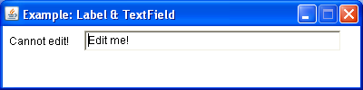
Label and TextField
A Label displays a string that cannot be changed by a user
A TextField allows a user to enter or edit one line of text
A FlowLayout arranges components :
  in a directional flow (left-to-right, or right-to-left)
  horizontally until no more components fit on the same line
import java.awt.*;
import java.awt.event.*;
class LTF extends Frame {
LTF()
{
super("Example: Label & TextField");
setLayout(new FlowLayout(FlowLayout.LEFT));
setResizable(false);
add(new Label("Cannot edit!"));
final TextField tf = new TextField("Edit me!",37);
tf.addTextListener(new TextListener() {
public void textValueChanged(TextEvent te)
{
System.out.println(te.paramString());
}
});
add(tf);
setSize(400,100);
}
public static void main(String[] args)
{
new LTF().setVisible(true);
}
}
Java Programming

Slide 12
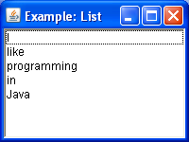

List
The List component presents the user with a scrolling list of text items
It can be set up so that the user can choose either one item or multiple items
import java.awt.*;
import java.awt.event.*;
class LST extends Frame {
LST()
{
super("Example: List");
final List l = new List();
l.add("I");
l.add("like");
l.add("programming");
l.add("in");
l.add("Java");
l.addItemListener(new ItemListener() {
public void itemStateChanged(ItemEvent ie)
{
System.out.println(ie.paramString());
}
});
add(l);
setSize(200,150);
}
public static void main(String[] args)
{
new LST().setVisible(true);
}
}
Mouse click
Java Programming

Slide 13
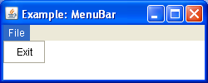
Menu, MenuBar and MenuItem
A frame may contain a menu bar with options (i.e. items)
When the mouse is clicked on an option a drop down menu appears
Each menu consists of one or more menu items
import java.awt.*;
import java.awt.event.*;
class MNB extends Frame {
MNB()
{
super("Example: MenuBar");
final MenuBar mb = new MenuBar();
setMenuBar(mb);
final Menu m = new Menu("File");
MenuItem mi;
mi = new MenuItem("Exit");
mi.addActionListener(new ActionListener() {
public void actionPerformed(ActionEvent ae)
{
System.exit(0);
}
});
m.add(mi);
mb.add(m);
setSize(250,100);
}
public static void main(String[] args)
{
new MNB().setVisible(true);
}
}
Java Programming

Slide 14
Layout Managers
A layout manager helps in arranging the components in a container
Each layout manager:
  Encapsulates an algorithm for positioning and sizing of components
  Automatically calculates the coordinates of each component it manages
  If a container is resized, the layout manager readjusts the placement of the components
Java Programming

Slide 15
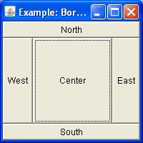
BorderLayout
Allows placing of components by using the geographic terms:
  CENTER
  EAST
  NORTH
  SOUTH
  WEST
The components are placed around the edges
The component in the center uses the remaining space
import java.awt.*;
import java.awt.event.*;
class BLM extends Frame {
BLM()
{
super("Example: BorderLayout");
setLayout(new BorderLayout());
add(new Button("Center"),BorderLayout.CENTER);
add(new Button("East"),BorderLayout.EAST);
add(new Button("North"),BorderLayout.NORTH);
add(new Button("South"),BorderLayout.SOUTH);
add(new Button("West"),BorderLayout.WEST);
setSize(200,200);
}
public static void main(String[] args)
{
new BLM().setVisible(true);
}
}
Java Programming

Slide 16
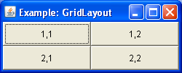
GridLayout
Automatically arranges components in a grid of rows and columns
The container is divided into equal-sized cells, and one component is placed in each cell
import java.awt.*;
import java.awt.event.*;
class GLM extends Frame {
GLM()
{
super("Example: GridLayout");
setLayout(new GridLayout(2,2));
add(new Button("1,1"));
add(new Button("1,2"));
add(new Button("2,1"));
add(new Button("2,2"));
setSize(250,100);
}
public static void main(String[] args)
{
new GLM().setVisible(true);
}
}
Java Programming

Slide 17
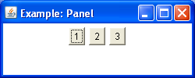
Panel
Panel is the simplest container class
A panel provides space in which an application can attach any other component, including other panels
The default layout manager for a panel is the FlowLayout manager
import java.awt.*;
import java.awt.event.*;
class PNL extends Frame {
PNL()
{
super("Example: Panel");
final Panel p = new Panel();
p.add(new Button("1"));
p.add(new Button("2"));
p.add(new Button("3"));
add(p);
setSize(250,100);
}
public static void main(String[] args)
{
new PNL().setVisible(true);
}
}
Java Programming

Slide 18
Swing
Differences between AWT and Swing:
  Swing components use no native code and they can be present on every platform
  Typically, Swing components start their names with ‘J’
  Have capabilities beyond what equivalent AWT components can offer
  Swing components need not be rectangular
  Swing components can dynamically change their appearance (i.e. pluggable look-and-feel)
Java Programming

Slide 19
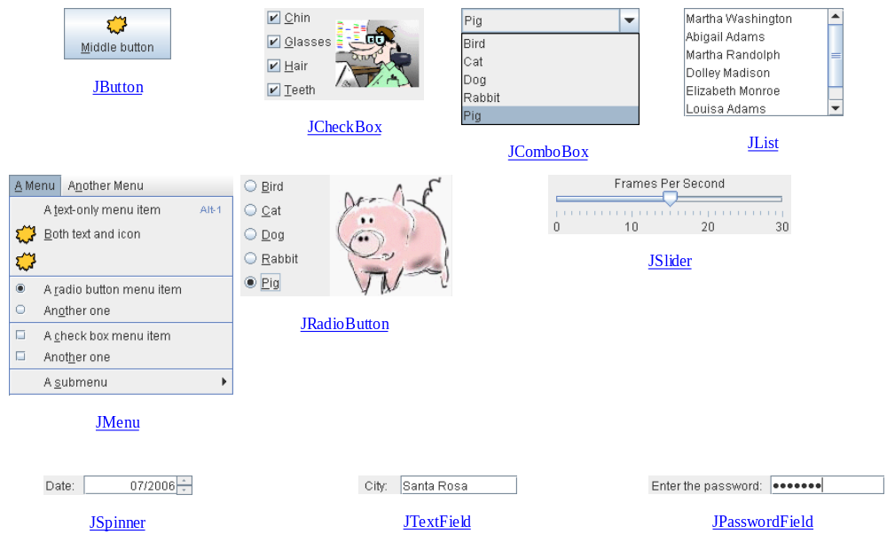
Swing Components (Java Look and Feel)
Java Programming

Slide 20
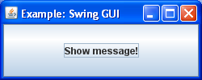
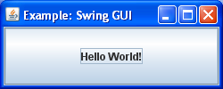
Example: Hello World
import java.awt.*;
import java.awt.event.*;
import javax.swing.*;
class HLW extends JFrame {
HLW()
{
super("Example: Swing GUI");
final JButton b = new JButton("Show message!");
b.addActionListener(new HLWButtonListener(b));
add(b);
setSize(250,100);
}
public static void main(String[] args)
{
new HLW().setVisible(true);
}
}
class HLWButtonListener implements ActionListener {
private JButton jb;
HLWButtonListener(JButton b)
{
jb = b;
}
public void actionPerformed(ActionEvent e)
{
jb.setText("Hello World!");
}
}
Mouse click
ActionEvent
Java Programming

Slide 21
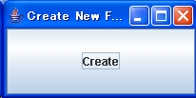

Creating New Window Frame
// Dialog Box
import java.util.*;
import java.awt.*;
import java.awt.event.*;
import javax.swing.*;
public class CreatNewFrame extends JFrame
{
JLabel client_title;
JButton create_button;
public CreatNewFrame() {
getContentPane().setLayout(new GridLayout(1,0));
create_button = new JButton("Create");
create_button.addActionListener(new ButtonListener());
getContentPane().add(create_button);
}
class ButtonListener implements ActionListener {
public void actionPerformed(ActionEvent e) {
NewFrame nf = new NewFrame();
nf.addWindowListener(new WindowAdapter() {
public void windowClosing(WindowEvent e) {System.exit(0);}
});
nf.setTitle("New Window Frame");
nf.setSize(200,150);
nf.setVisible(true);
}
}
public static void main (String args[]) {
CreatNewFrame f = new CreatNewFrame();
f.addWindowListener(new WindowAdapter() {
public void windowClosing(WindowEvent e) {System.exit(0);}
});
f.setTitle("Create New Frame");
f.setSize(200,150);
f.setVisible(true);
}
} // end of CreatNewFrame
class NewFrame extends JFrame {
JLabel label;
public NewFrame() {
getContentPane().setLayout(new FlowLayout());
label = new JLabel("Another New Frame");
getContentPane().add(label);
} // NewFrame constructor
} // end of NewFrame class
Button clicked
Java Programming

Slide 22
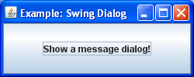
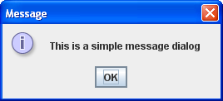
Dialogs
A dialog is a special window to convey a message or provides a special function
Every dialog is dependent on a frame – when that frame is destroyed, so are its dependent dialogs
A modal dialog blocks user input to all other windows in the program
import java.awt.*;
import java.awt.event.*;
import javax.swing.*;
class DLG extends JFrame {
DLG()
{
super("Example: Swing Dialog");
final JFrame jf = this;
final JButton jb = new JButton("Show a message dialog!");
jb.addActionListener(new ActionListener() {
public void actionPerformed(ActionEvent ae) {
JOptionPane.showMessageDialog(jf,"This is a simple message dialog");
}
});
add(jb);
setSize(250,100);
}
public static void main(String[] args)
{
new DLG().setVisible(true);
}
}
Java Programming

Slide 23
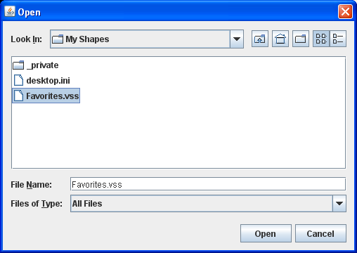

FileChooser
File choosers provide a GUI for navigating the file system or open a file
To display a file chooser, use the JFileChooser API to show a modal dialog containing the file chooser
import javax.swing.*;
class FCH extends JFrame {
final JLabel jl = new JLabel();
FCH()
{
super("Example: Swing FileChooser");
add(jl);
setSize(300,50);
}
public static void main(String[] args)
{
final FCH fch = new FCH();
final JFileChooser jfc = new JFileChooser();
fch.setVisible(true);
final int val = jfc.showOpenDialog(fch);
if(val == JFileChooser.APPROVE_OPTION)
fch.jl.setText("You chose to open this file: " + jfc.getSelectedFile().getName());
}
}
Java Programming

